Slide 1
How to Submit Proposals for Scientific Programs for FIPS-ASSOPICON 2024

Slide 2
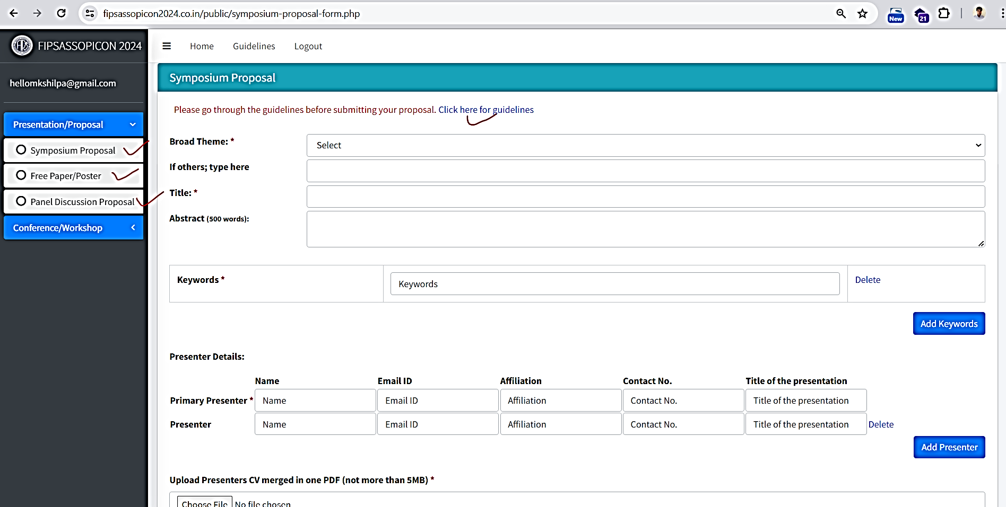
How to submit proposal for Symposium, Free Paper or Poster Presentation and Panel Discussion Proposal for FIPS-ASSOPICON 2024
You may submit proposals for Symposium, Free Paper or Poster Presentation and Panel Discussion. The proposal will be rigorously reviewed by the conference scientific committee.
Subject to acceptance by the scientific committee, an email for provisional acceptance will be sent. Before final presentation, the conference registration and realization of payment would be essential.
The proposals may be submitted on the web portal under the heads Symposium, Free Paper or Poster Presentation and Panel Discussion.
Kindly go through the guidelines for submission before submitting the proposals.

Slide 3
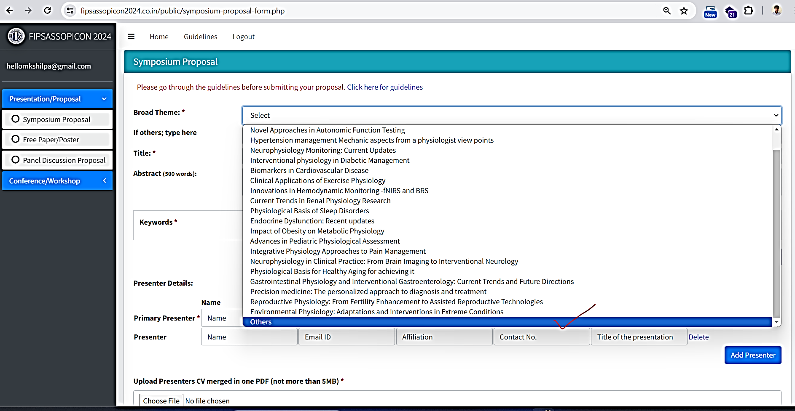
How to submit proposal for Symposium
Go through the guideline.
Open ‘Symposium Proposal’ format. Select your broad theme or select ‘Others’ to input any theme that is not mentioned in the drop down.
Fill up title and the main abstract. The main abstract will be in addition to the individual speaker’s abstract which has to be added separately.

Slide 4
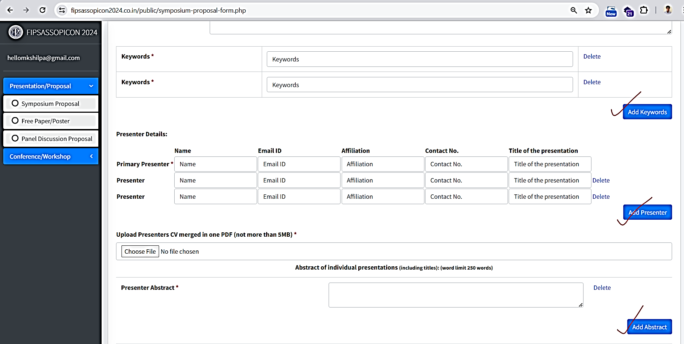
How to submit proposal for Symposium
Add presenters and key words by clicking on ‘add presenter’ or ‘Add Keywords’ button.
Add individual presenters abstract which is in addition to the main abstract.
Merge the CVs of all the presenters in to single pdf and upload the merged CV.

Slide 5
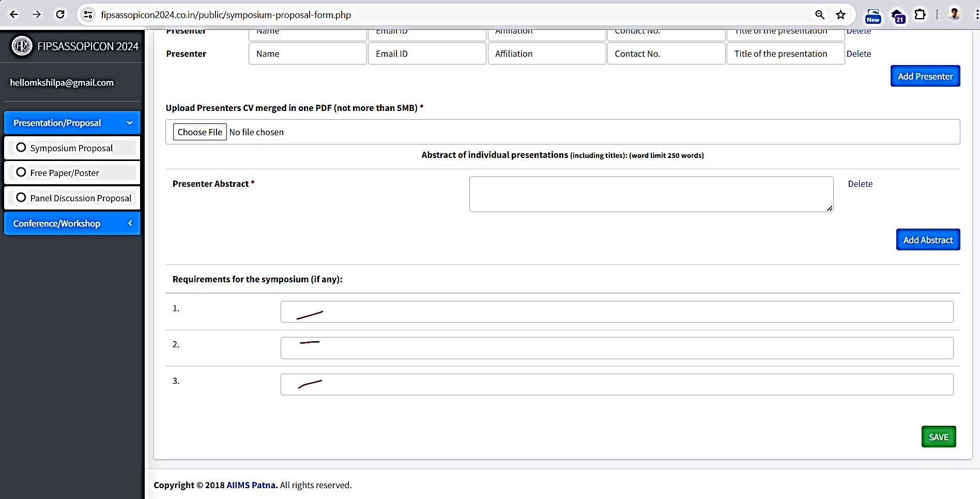
How to submit proposal for Symposium
If there’s any requirement for the Symposium you can mention or leave blank.
After submitting the proposal, you will receive a confirmation message of successful submission. The Scientific Committee will review your proposal and send you an email for the provisional acceptance of the proposal.

Slide 6
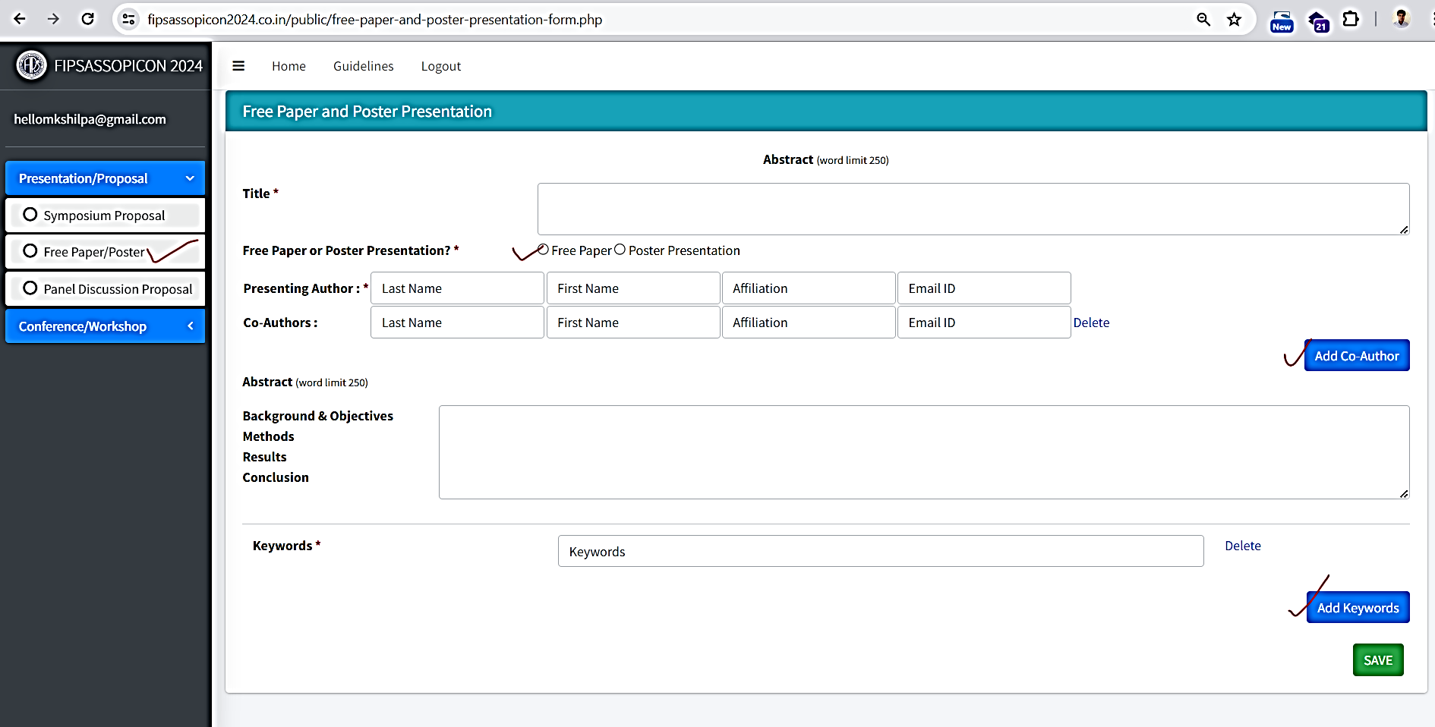
How to submit proposal for Free Paper and Poster Presentation
Input title. Select Free Paper or Poster presentation. You can add multiple authors and keywords. Fill up the abstract and submit.
The Scientific Committee will review your proposal and send you confirmation mail of proposal accepted.

Slide 7
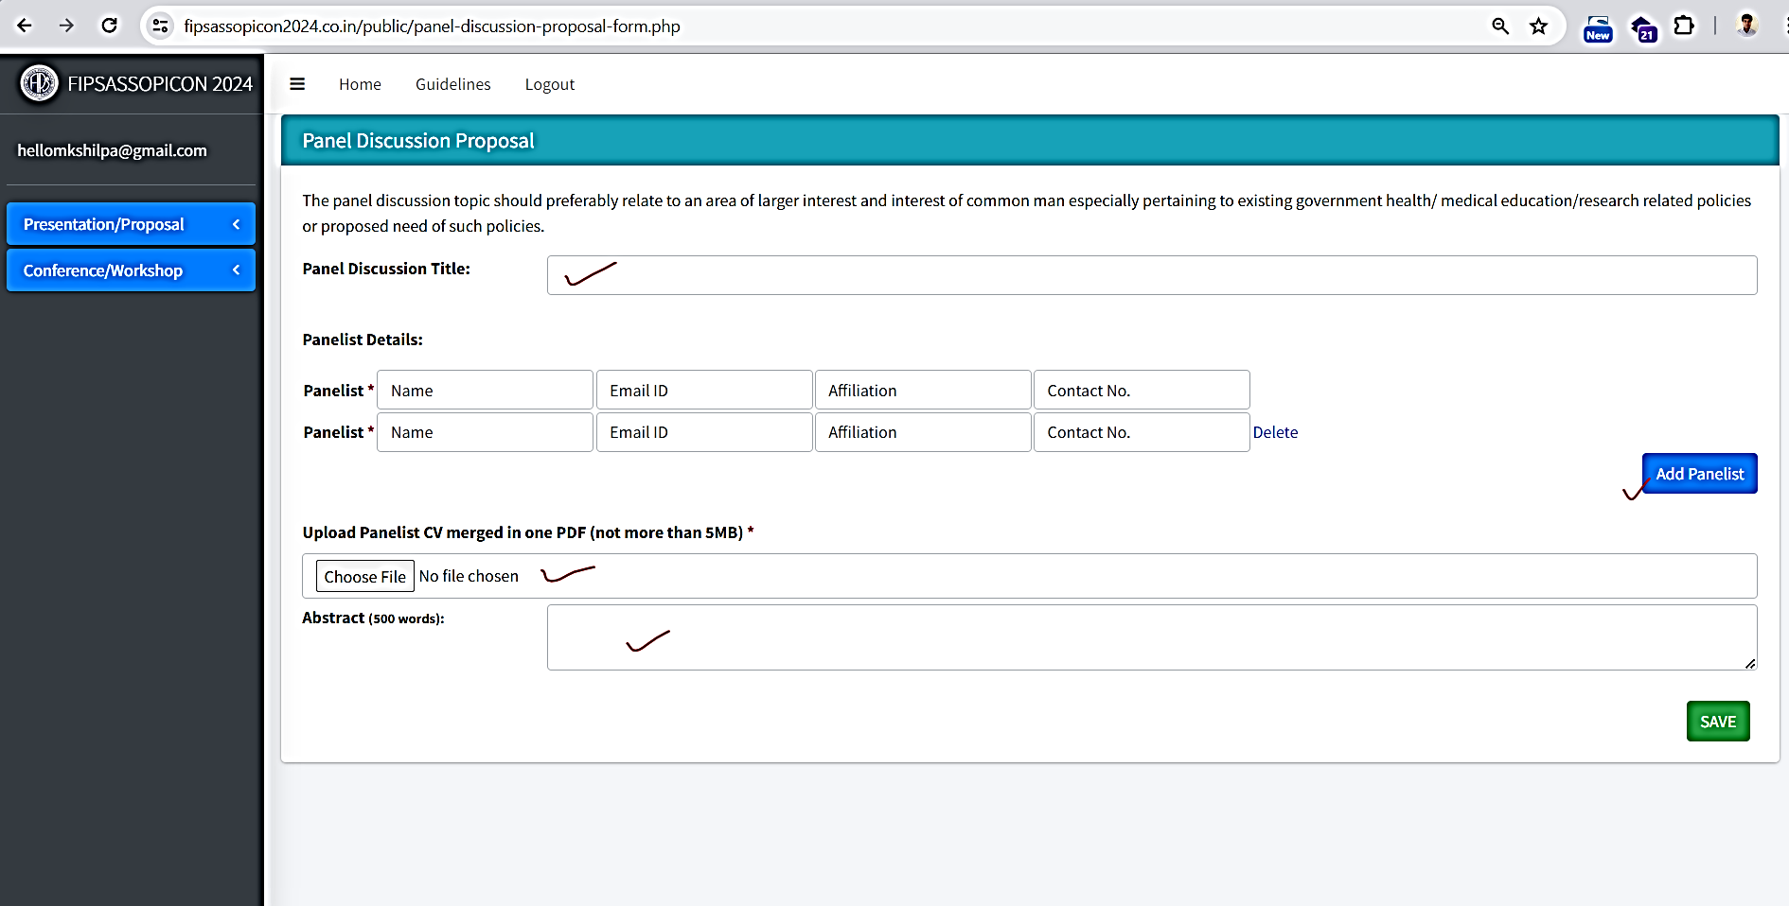
How to submit proposal for Panel Discussion Proposal
Input your panel discussion title. Add panellist details. You can add multiple panellist. Merge their CVs in one document and upload. Fill up the abstract and submit.
The Scientific Committee will review your proposal and send you confirmation mail of proposal accepted.

Slide 8
Thank You
For further more assistance, please contact us :
Department of Physiology, AIIMS Patna
Aurangabad Road, Phulwarisharif
Patna, Bihar-801507
Phone: +91-7479733436, +91-8019332484
Email: fipsassopicon@gmail.com, info@fipsassopicon2024.co.in

